Slide 1
Tree Team
“Be eco-friendly or don’t be friendly at all”
Madelyn Olaerts
Delaney Hallstrom
Mason Geloso
Spencer Dennis
Notes:
maddy

Slide 2
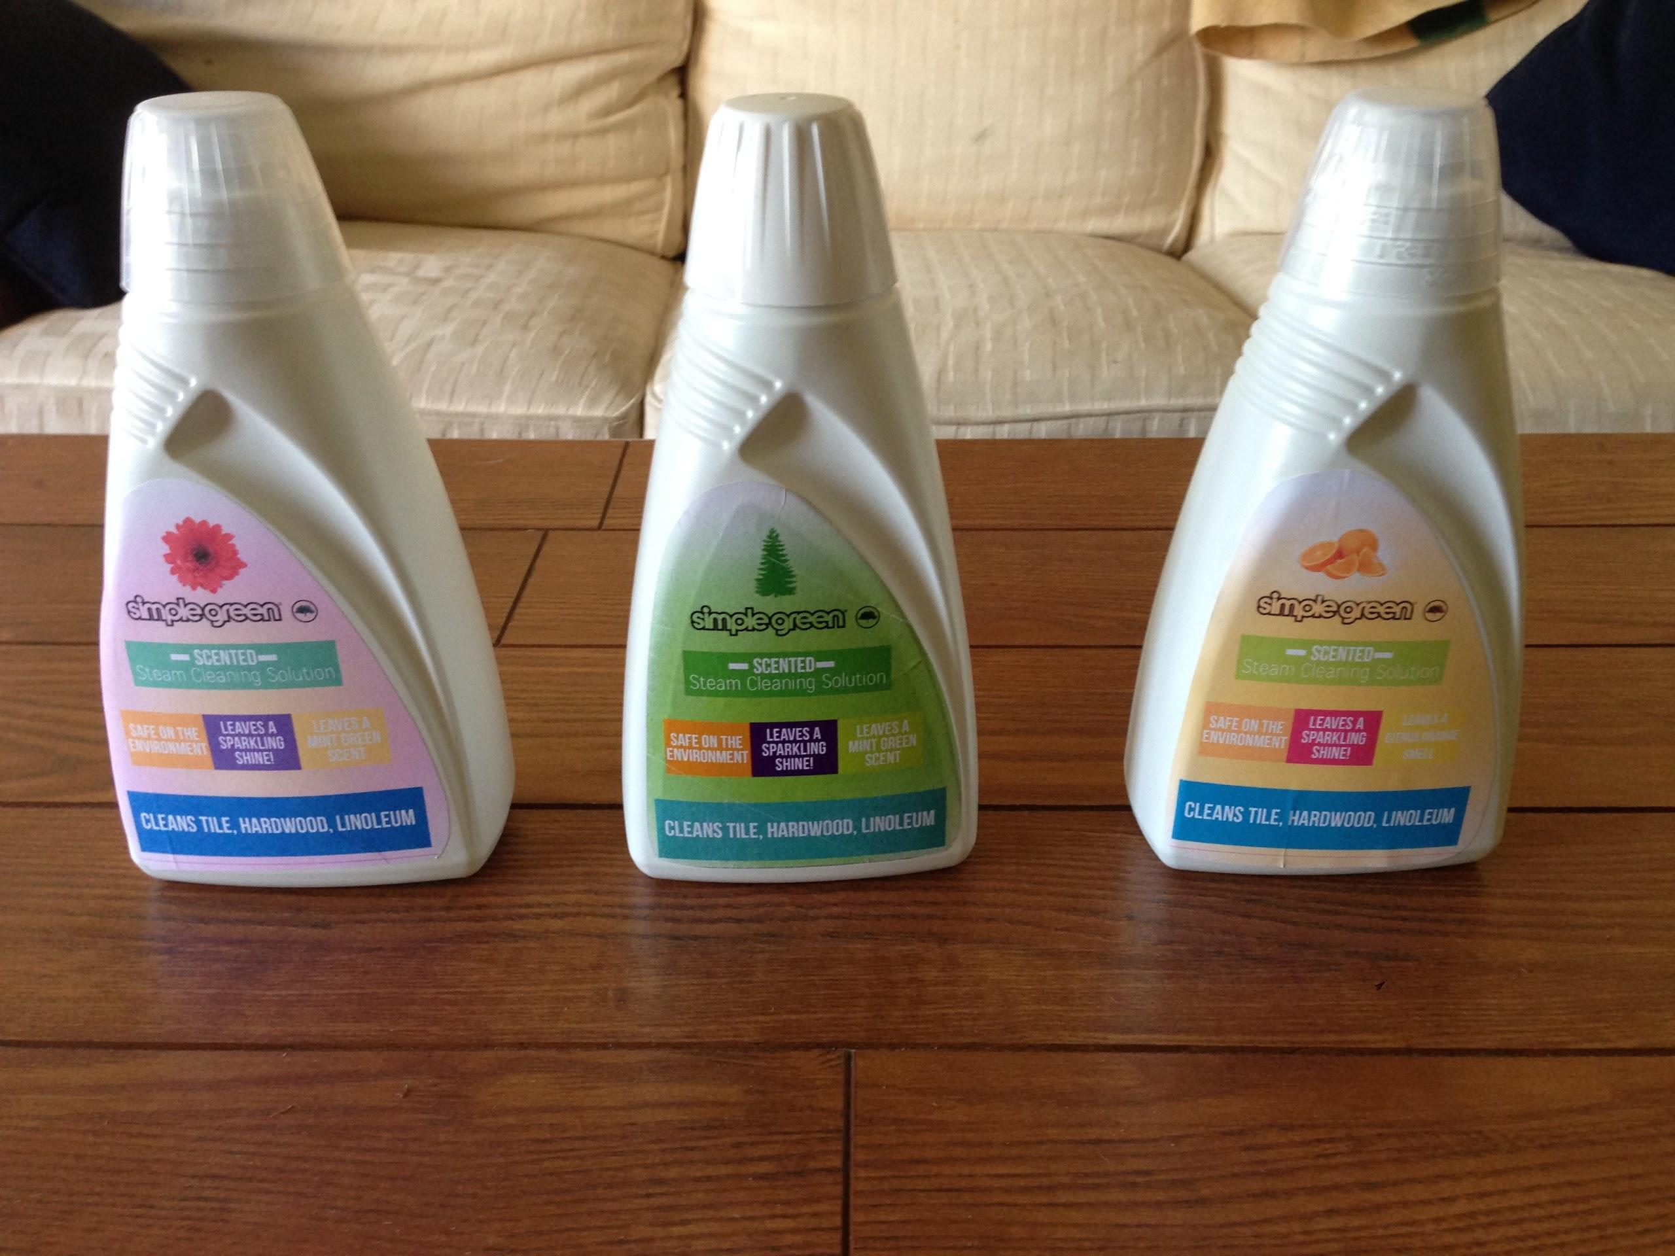
Our Product
What is it?
Why is it different?
Why will it sell?
Notes:
Mason

Slide 3
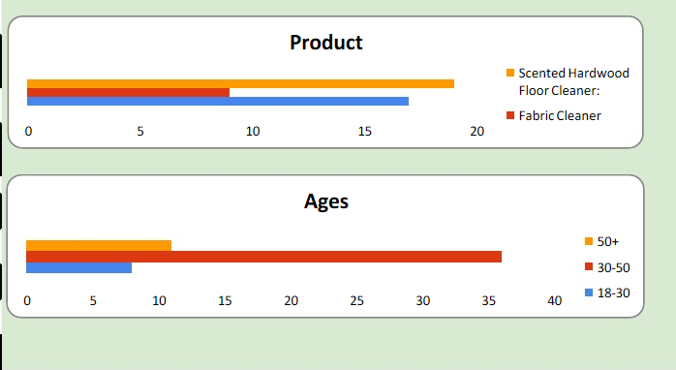
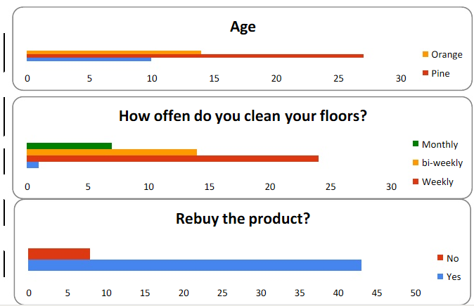
Surveys
Surveys show:
Mint Green
Most would rebuy the product
Between $3-$4
Floors cleaned weekly
Notes:
delaney

Slide 4
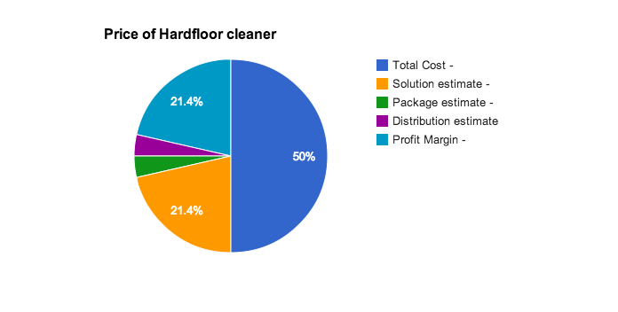
Prices
Selling Price - $3.50
Solution estimate - $1.50
Package estimate - $.25
Distribution estimate- $.25
Profit Margin - $1.50
Notes:
Mason

Slide 5
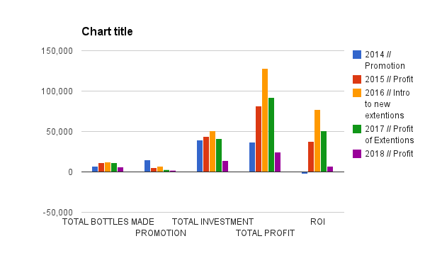
5 Year Plan

Slide 6
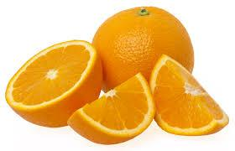
Possible Additions
Possible new smells
New packaging
Different types of this cleaner including:
Heavy duty
Light
Concentrate
Notes:
Spencer

Slide 7
Marketing Analysis
Target market?
New Market to be opened/Already exists
Lots of growth possibility
Spa, home stores, or warehouses
Notes:
Delaney

Slide 8
Advertising (Pricing)
Commercial Ads
Youtube : Ad Targeting & In-stream
- CPC $.04
Online Ads
Google
- Manageable daily budgets
Notes:
Madelyn

Slide 9
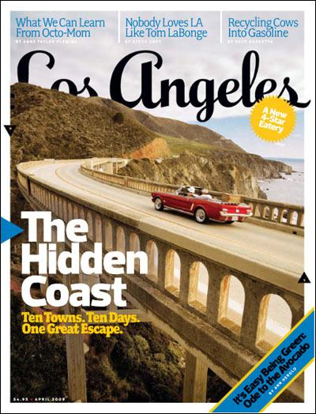
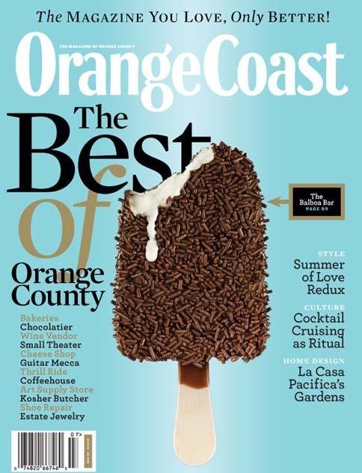
Advertising (Pricing)
Magazine Ads
Los Angeles, Coastal Living, Orange Coast
Regional
- $2,000 one time or $1,500 ea. (commitment)
Notes:
Madelyn

Slide 10
Distribution
Transportation:
$3,000 = rental of a truck
Each truck can hold 26 pallets (50 bottles)
It will cost around $.43 to ship the product.
Notes:
Spencer

Slide 11
Tree Team
Questions? Comments? Contact Us!
Email : treeteamsimplegreen@gmail.com
Phone : 1(714) 862-5269
Thank you for your time!
Notes:
delaney

